Slide 1

Retail Case Study Analysis
Understanding Customer Behavior and Campaign Response

Slide 2






Kind of customers respond to different campaigns
Income level impact spending on specific product categories
Business Problem
Objective: The retailer aims to understand customer behavior and campaign response to optimize marketing strategies and enhance customer engagement.
Complaint patterns of recent customers compared to older customers
Correlation between campaign acceptance in the first and subsequent campaigns
Distinguishing characteristics of customers who respond to campaigns versus those who do not

Slide 3


Data Quality Check
Data Cleaning
Clean 'Income' column: Remove spaces, currency signs, commas, and convert to integer type.
Convert 'Dt_Customer' to datetime format for date consistency.
Calculate age from 'Year_Birth' for demographic analysis.
Note: 24 missing values in the 'Income' column for further handling
Load Demographics Data (txt)
Load Behavioral Data (json)
Load Campaign Data (json)
Merge Data on ID Column
Perform Data Cleaning and Transformation
Generate Consolidated Dataset
Data Consolidation Process

Slide 4
Data Quality Report
Income_$:
Mean: $51,687.46
Age:
Mean: 55.19 years
Standard Deviation: 11.98 years
Outliers Count: 3
Min: 28 years,
MntWines:
Mean:303.94
Standard Deviation: 336.60
Outliers Count: 35
Min: 0,
MntFruits:
Mean:26.30
Standard Deviation: 39.77
Outliers Count: 227
Min: 0,
MntMeatProducts:
Mean: 166.95
Standard Deviation: 225.72
Outliers Count: 175
Min: 0,
MntFishProducts:
Mean: 37.53
Standard Deviation: 54.63
Outliers Count: 223
Min: 0,
MntSweetProducts:
Mean: 27.06
Standard Deviation: 41.28
Outliers Count: 248
Min: 0,
MntGoldProds:
Mean: 44.02
Standard Deviation: 52.17
Outliers Count: 207
Min: 0,
Standard Deviation: $25,609.34
Outliers Count: 8
Min: $0,
25th percentile: $34,722.00,
Median: $51,075.00,
75th percentile: $68,289.75,
Max: $666,666.00
25th percentile: 47 years,
Median: 54 years,
75th percentile: 65 years,
Max: 131 years
25th percentile: 23.75,
Median: 173.50,
75th percentile: 504.25,
Max: 1,493
25th percentile: 1,
Median: 8,
75th percentile: 33,
Max: 199
25th percentile: 16,
Median: 67,
75th percentile: 232,
Max: 1,725
25th percentile: 3,
Median: 12,
75th percentile: 50,
Max: 259
25th percentile: 1,
Median: 8,
75th percentile: 33,
Max: 263
25th percentile: 9,
Median: 24,
75th percentile: 56,
Max: 362
Education:
Unique values: Graduation' 'PhD' '2n Cycle' 'Master' 'Basic'
Marital_Status:
Unique values: 'Divorced' 'Single' 'Married' 'Together' 'Widow' 'YOLO' 'Alone' 'Absurd'
Country:
Unique values: 'SP' 'CA' 'US' 'AUS' 'GER' 'IND' 'SA' 'ME'

Slide 5


Business Analysis and Hypothesis
OBJECTIVE 1
Generate and test hypothesis related to amount spent on different product categories and response rates in marketing campaigns.
Importance of Hypothesis Testing:
Hypothesis testing provides a structured approach to validate assumptions and draw meaningful conclusions from data.
It helps in uncovering patterns, relationships, and insights that drive informed decision-making in marketing strategies.
Campaign Impact on Spending:
Campaigns like AcceptedCmp1, AcceptedCmp4, and AcceptedCmp5 significantly influence spending behavior across various product categories.
Not all campaigns show a significant impact on customer spending habits, as seen in campaigns like AcceptedCmp2 and AcceptedCmp3 for certain product categories.

Slide 6

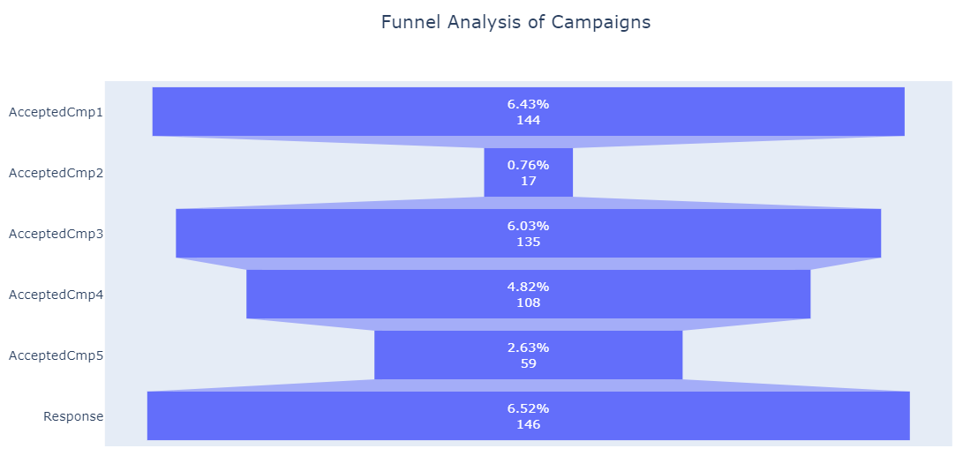
OBJECTIVE 2
Funnel Analysis showing unique customer acceptance showing in each campaign
Higher Engagement Campaigns:
Campaigns 1, 3, and Response show relatively higher counts, indicating stronger customer engagement with these campaigns.
Lower Response Campaigns:
Campaigns 2, 4, and 5 have lower counts, suggesting lower levels of customer response or acceptance to these specific campaigns.
Positive Response Rate:
Response stage has the highest count among all stages, indicating a significant number of customers responded positively to the final campaign.

Slide 7

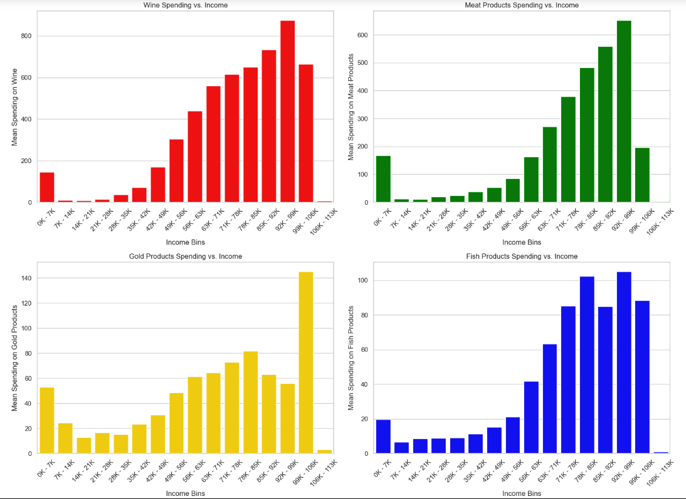
OBJECTIVE 3
Income impacts on the amount spent - Wine - Meat Products - Gold Products - Fish Products
Positive Income-Spending Correlation:
Generally, as income increases, customers tend to spend more on wines, meat products, and gold products, reflecting a positive correlation between income and spending behavior.
Unique Behavior for Gold Products:
Spending on gold products exhibits a distinct pattern compared to other items. There is a peak in spending around the middle-income range, followed by a slight decrease in higher income brackets. This suggests nuanced perceptions or purposes associated with gold products across income levels.
Varied Patterns for Fish Products:
Spending on fish products shows less consistent patterns across income groups. While there is an overall increase in spending with income, fluctuations and inconsistencies are observed, indicating that factors beyond income influence spending behavior for fish products.

Slide 8

OBJECTIVE 4
The hypothesis that recent customers complain less in general compared to older customers
Chi-Square Test: Chi-square test is used to determine the association between two categorical variables. It assesses whether there is a significant relationship between the variables based on observed and expected frequencies.
Insights:
The analysis indicates that the recency of customers does not have a substantial impact on their complaint status, suggesting that customer complaints are not significantly influenced by how recently a customer has interacted with the business.
Understanding that recency does not play a significant role in complaint status can help businesses focus on addressing customer concerns and improving overall satisfaction, regardless of when the customer last engaged with the company.

Slide 9

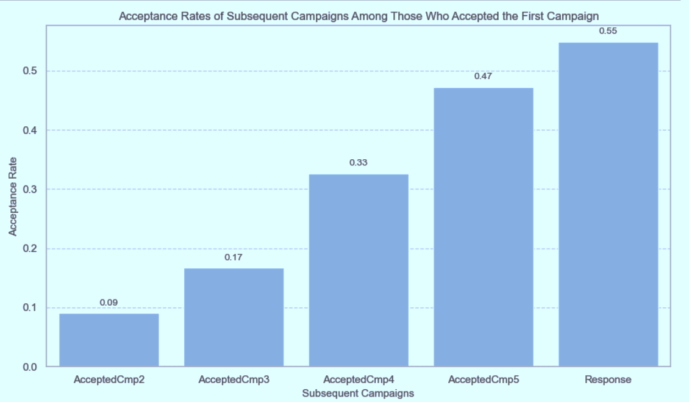
OBJECTIVE 5
Whether people who accept the offer in the first campaign also accept in any other campaign?
Progressive Acceptance Trend:
Witness a gradual increase in acceptance rates from AcceptedCmp2 to Response among customers who initially accepted the first campaign. This trend signifies a positive response escalation over successive campaigns.
Noteworthy Response Surge:
Experience a significant surge in acceptance rates between AcceptedCmp4 and AcceptedCmp5, with a jump from 0.33 to 0.47. This surge suggests heightened effectiveness in engaging customers who positively responded to the initial campaign.
Peak Engagement at Final Stage:
Observe the pinnacle of acceptance rates at 0.55 during the Response campaign, indicating a substantial portion of initial responders continuing engagement through subsequent campaigns, culminating in a favorable response to the final campaign.

Slide 10

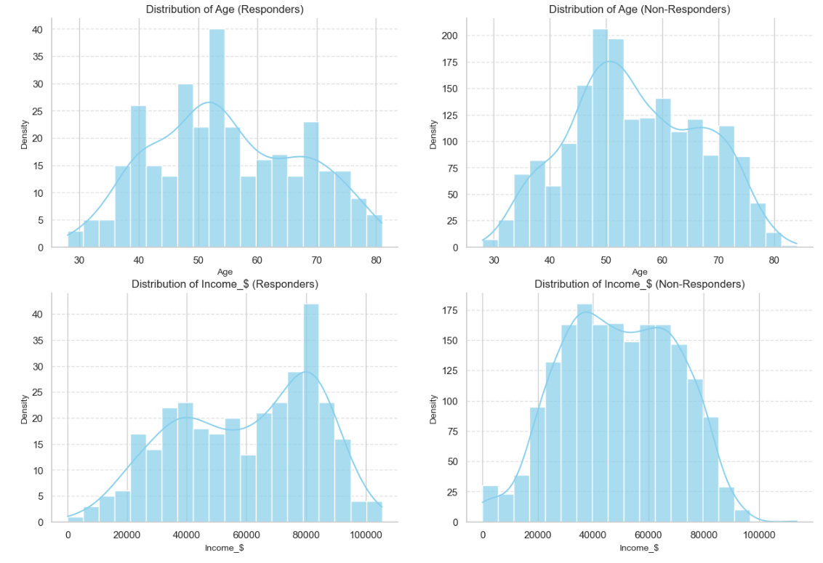
OBJECTIVE 6
Profile of people who respond vs. who don’t
Age Distribution:
Responders: Concentrated between 1970-1985.
Non-Responders: Peak between 1972-1979, slightly older.
Education Level:
Responders: Graduation most common.
Non-Responders: Similar distribution with Graduation prevalent.
Marital Status:
Responders: Majority Single.
Non-Responders: More likely to be Married.
Income Disparity:
Responders: Higher mean income.
Non-Responders: Lower income bracket.
Family Composition:
Responders: Mostly no children at home.
Non-Responders: Similar distribution.
Teenage at Household :
Responders: Few have teenagers at home.
Non-Responders: More likely to have one teenager.
Geographic Representation:
Responders: Spain has the highest number.
Non-Responders: Spain leads in non-responder representation.

Slide 11

Conclusion and Recommendations
Key Findings:
Demographic Analysis: Responders are typically younger, more educated, and have higher incomes compared to non-responders.
Campaign Response Trend: Notable increase in acceptance rates across campaigns, with the most significant jump between AcceptedCmp4 and AcceptedCmp5.
Geographic Distribution: Spain stands out as the primary country of responders, indicating a strong market presence in that region.
Insights:
Age and Education Influence: Age and education level play a significant role in campaign response, with younger, more educated individuals showing higher engagement.
Income Impact: Income disparity between responders and non-responders suggests potential pricing strategies or targeted promotions based on income brackets.
Recommendations:
Targeted Campaigns: Develop tailored campaigns for different age groups and educational backgrounds to maximize response rates.
Pricing Strategies: Implement dynamic pricing strategies based on income levels to appeal to a wider customer base.
Geographic Focus: Further invest in marketing efforts in Spain and explore opportunities for expansion in other high-response regions.
Customer Segmentation: Utilize demographic insights to segment customers effectively and personalize marketing strategies for better engagement and conversion rates.

